Slide 1


MEDICAL INSURANCE
By:
Mithul Murugaadev

Slide 2

AGENDA
Objective
Problem statement
Overview
Analysis
Recommendation
Conclusion

Slide 3

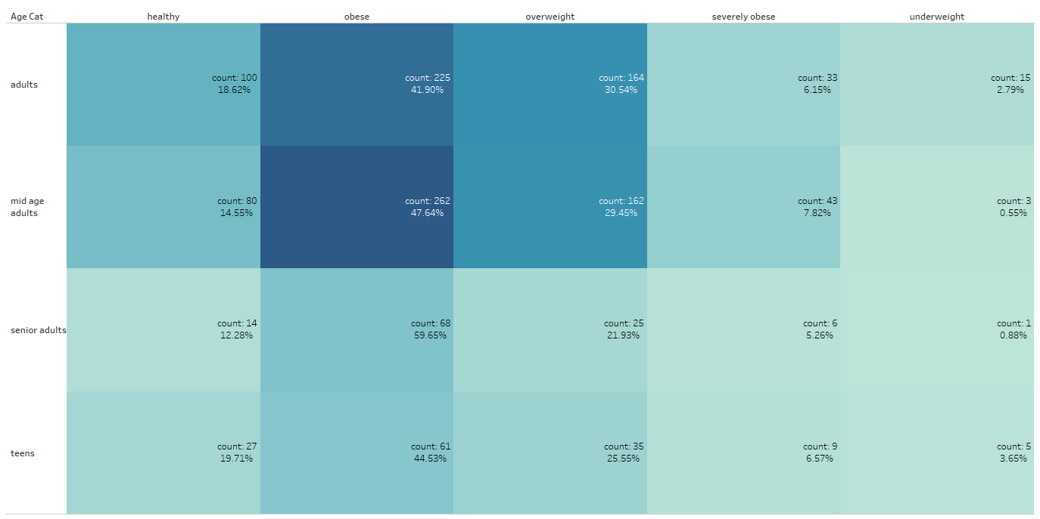
Generations move towards a healthier living
Senior adults and mid age adults are more prone to obesity
Teens show there is potential risk of rising obesity
Adults and mid age adults contribute a larger part of beneficiaries.
1

Slide 4
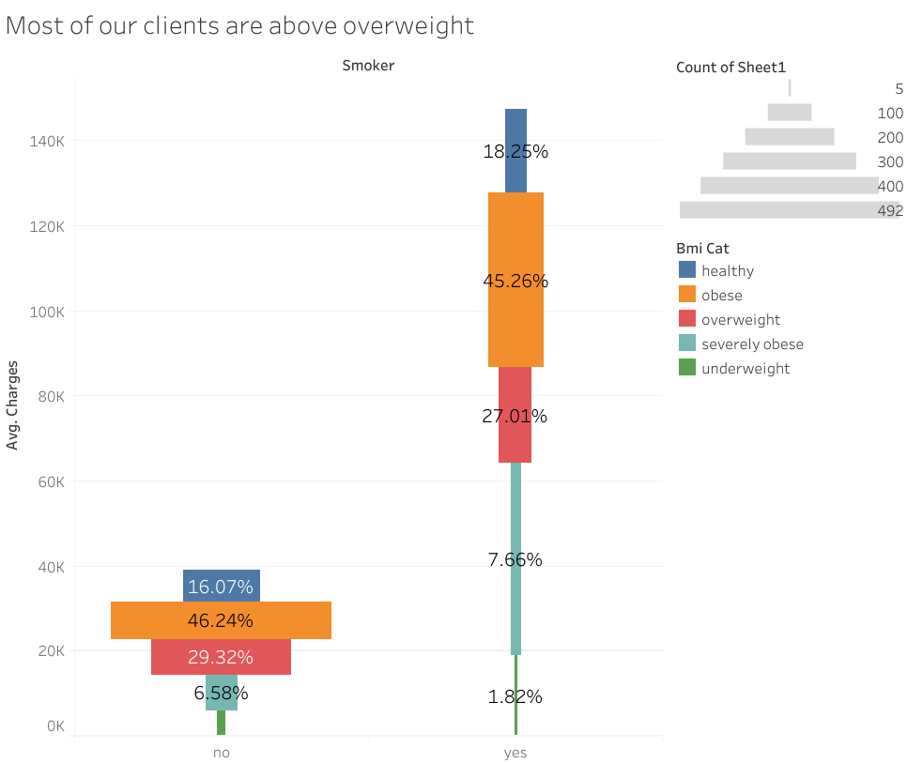
Smoking and obesity hit hard the expenditure scale
Irrespective of smoking habits, obese and overweight categories tend share a larger count of beneficiaries.
Average cost per person is prominently high for smokers
There are sizeable no. of no-smokers in the list of receivers.
2

Slide 5
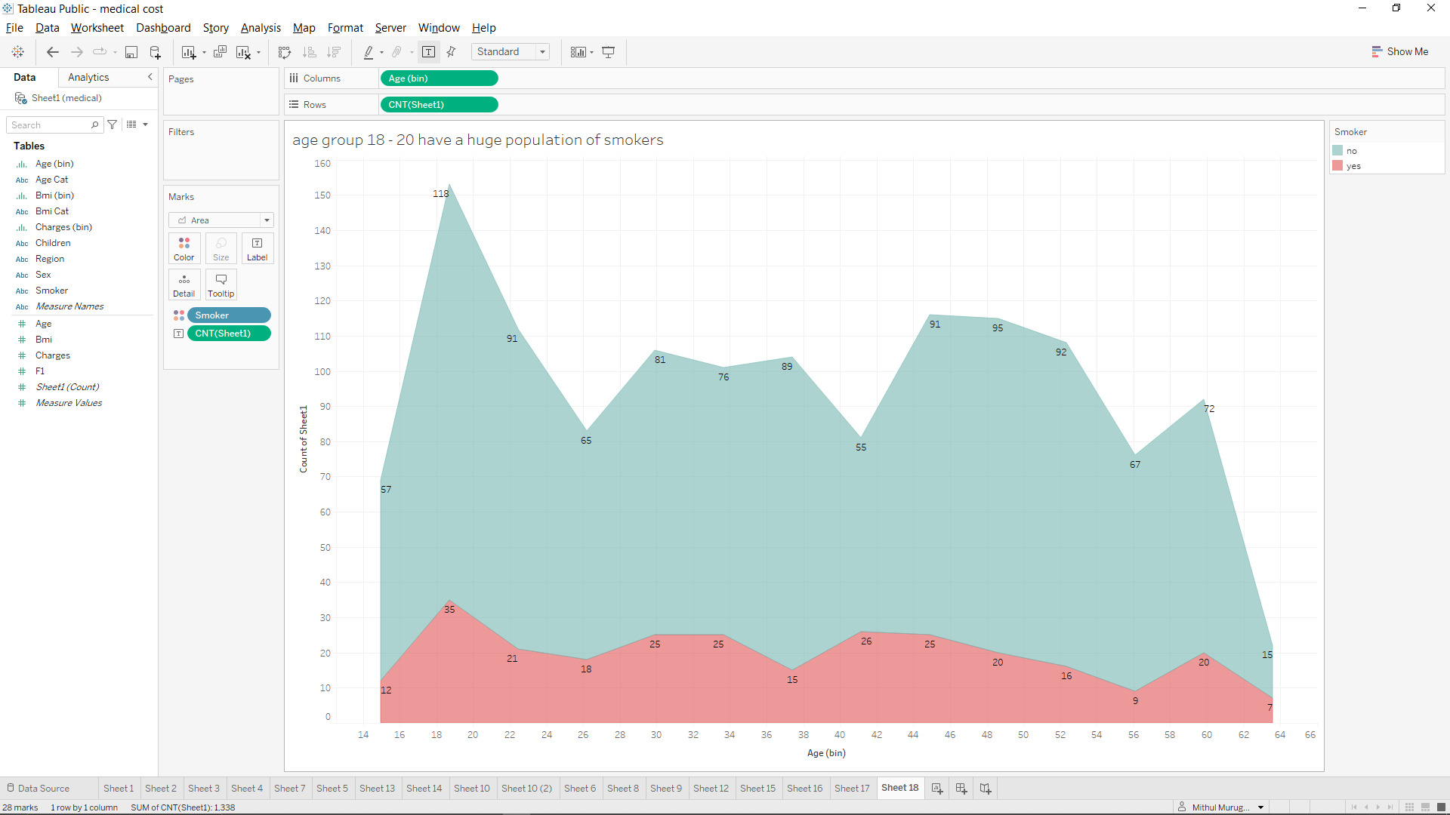
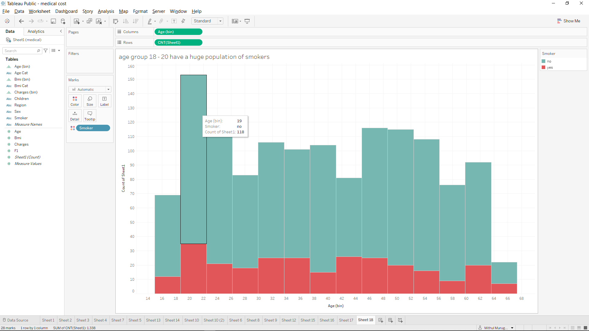
Alarming rate of old teen smokers
The 18-20 age group constitute a high portion of beneficiaries
The old teen age group also amount to a larger smokers population comparatively
There is a visible increase in smoking habits till the age group of 42-44
3

Slide 6
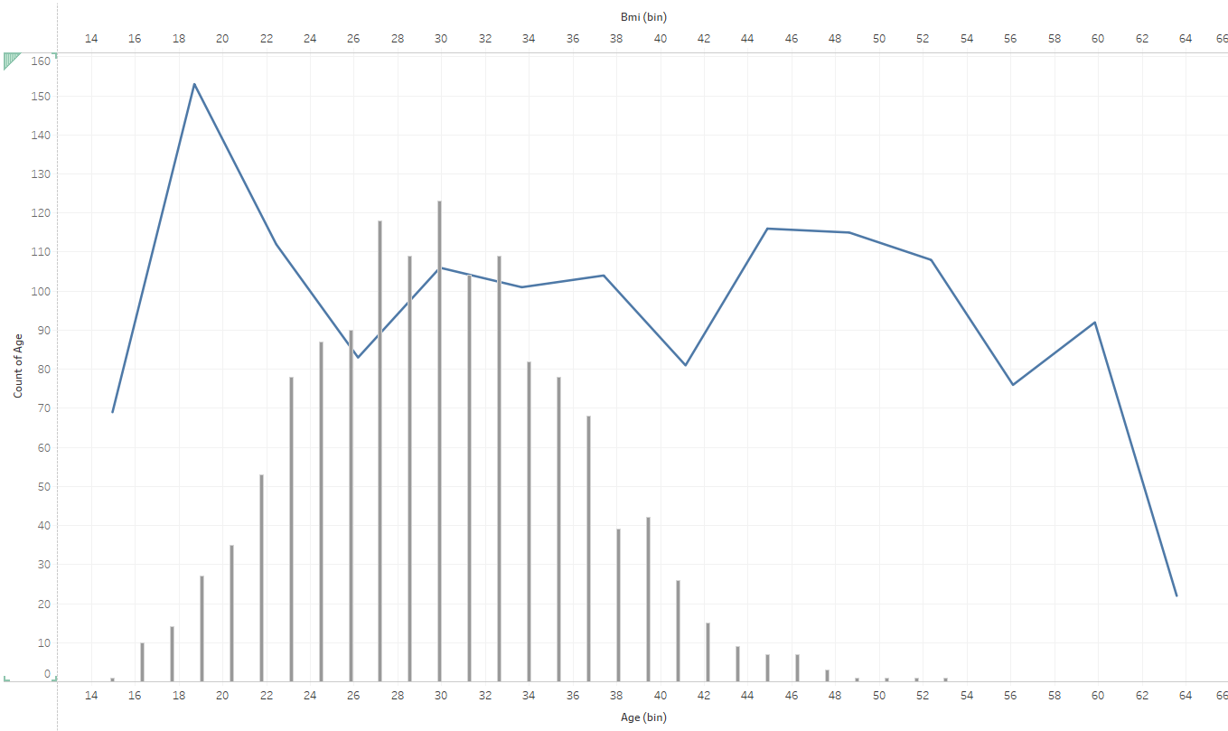
Obese cases are rising up
18-20 age group account for a large part of the beneficiaries.
Most of the policy holders are in the overweight, obese category.
4

Slide 7
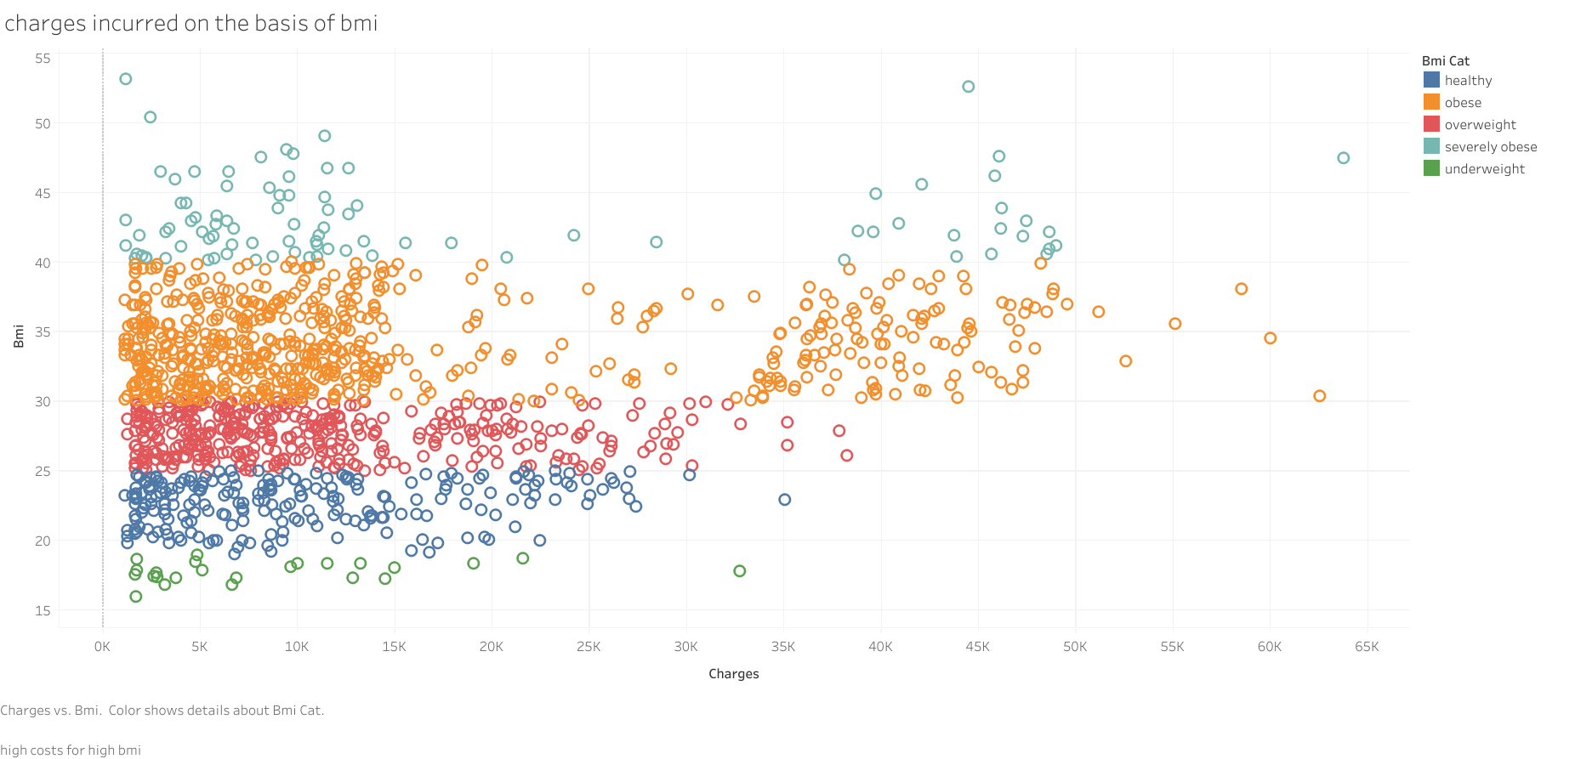
Poor Health is an early indicator of expenditure
Larger sum of charges are seen in the obese category.
Substantial density of population are in the overweight and obese category.
There is a microscale of increase in charges with increase in BMI
5

Slide 8
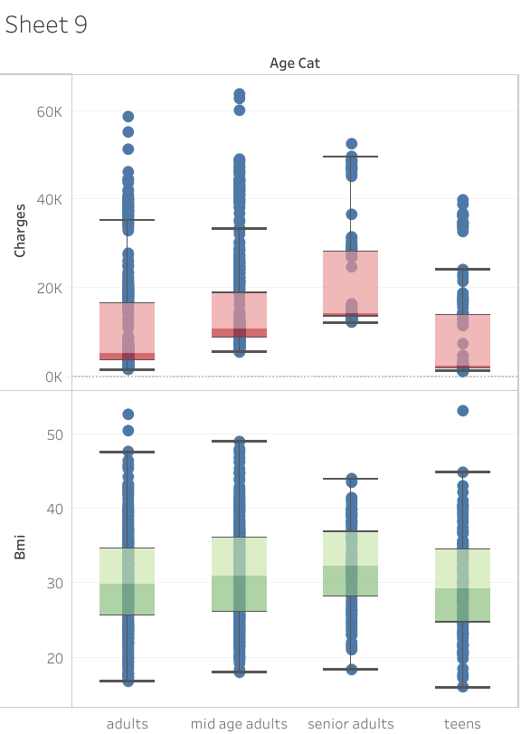
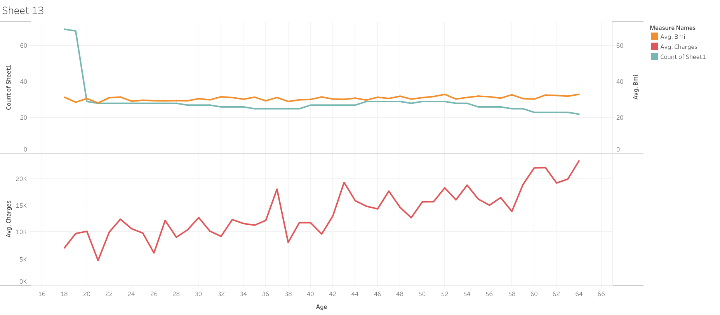
Older the age, higher the spend
The mid age adults and senior adults spend higher amounts proportionately
Adults and mid age adults have hefty bills.
Both these categories have an unhealthy BMI on average.
6

Slide 9
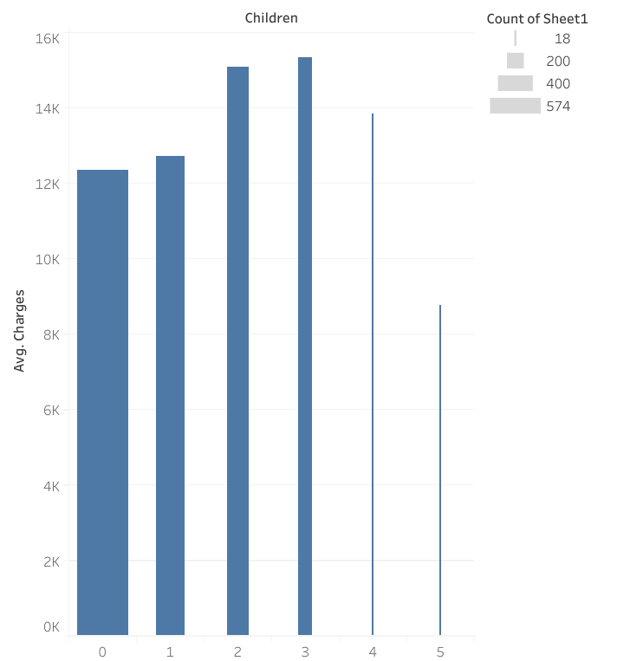
More dependencies cause Higher charges
sizable no. of Beneficiaries have lesser dependencies
Average charge is high for beneficiaries having 2 or more dependencies.
7

Slide 10

RECOMMENDATION
Target Adults and mid adults to invest more in medical insurance
Smokers comprise of a large medical bill coverage by insurance, target them for more investment income.
Beneficiaries with more dependencies rely on heavy bills.
Senior adults incur huge bills
Obesity leads to various chains of health issues. Unhealthy levels of BMI is an indicator of future burden of medical bills.
Young age groups can be made aware through various programs about the risk of leading an unhealthy lifestyle and its impact.
Influence care takers about how health insurance can be of a great help for the teens amid rising obesity and other health issues.
8

Slide 11
CONCLUSION
Targeting adults and mid age adults who are potential users.
Targeting beneficiaries with more dependencies result in more medical insurance usage.
Healthy lifestyle choices can decrease the burden in the future.
Rising smoking cases on older teens and young adults are an indicator of solid challenges in the near future.
Awareness programs highlighting the impact of smoking and obesity can be prioritized.
9

Slide 12
THANK YOU

